Slide 1
Threats to Information Security

Slide 2
Some Factors contributing to the increasing vulnerability of organizational information assets :
Evolution of the information technology resource
(Today’s interconnected, interdependent, wirelessly networked business environment)
Governmental legislation
Smaller, faster, cheaper computers and storage devices
Decreasing skills necessary to be a computer hacker
International organized crime taking over cybercrime
Increased employee use of unmanaged devices
Lack of management support

Slide 3
Key terms
Information resources are subject to a huge number of threats.
Examples :
computers and the information on them, information systems and applications, databases, etc
A threat to an information resource is :
any danger to which a system may be exposed.
The exposure of an information resource is :
the harm, loss, or damage that can result if a threat compromises that resource.
A system’s vulnerability is :
the possibility that the system will suffer harm by a threat.
Risk is
the likelihood that a threat will occur. Information systems controls are the procedures, devices, or software aimed at preventing a compromise to the system.

Slide 4
Threats to Information Systems
Whitman and Mattord (2003) classiﬁed threats into the following general categories:
Unintentional acts
Natural disasters
Technical failures
Management failures
Deliberate acts

Slide 5
Unintentional Acts
Unintentional acts: those with no malicious intent.
Types of unintentional acts :
human errors,
deviations in the quality of service by service providers,
environmental hazards

Slide 6
Human Errors
Category of organizational employees is :
Regular employee :
from mail clerks to CEO
HRD and IS
contract labor, consultants, and janitors and guards.
Human errors or mistakes by employees caused by laziness, carelessness, or lack of information security awareness pose a large problem for organizations.

Slide 7
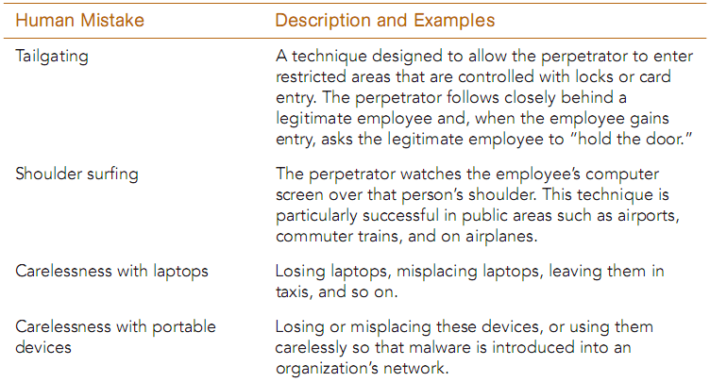
Human Mistakes (1)

Slide 8
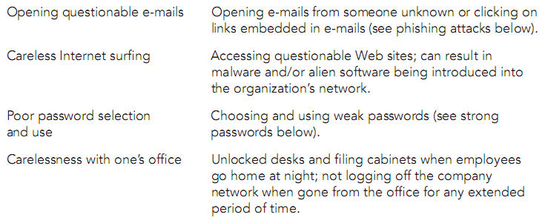
Human Mistakes (2)

Slide 9
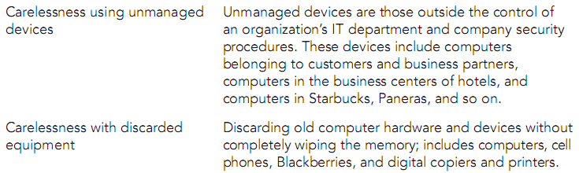
Human Mistakes (3)

Slide 10
Social Engineering and Reverse Social Engineering.
Social engineering is an attack whereby the perpetrator uses social skills to trick or manipulate a legitimate employee into providing conﬁdential company information such as passwords
Reverse social engineering: the employees approach the attacker.

Slide 11
Deviations in the Quality of Service by Service Providers
This category consists of situations in which a product or service is not delivered to the organization as expected.

Slide 12
Environmental Hazards
Environmental hazards include dirt, dust, humidity, and static electricity.
These hazards are harmful to the safe operation of computing equipment.

Slide 13
Technical Failures
Problems with hardware and software
The most common hardware problem is a crash of a hard disk drive
The most common software problem is errors—called bugs—in computer programs.

Slide 14
Management Failures
Management failures involve a lack of funding for information security efforts and a lack of interest in those efforts.
Such lack of leadership will cause the information security of the organization to suffer.

Slide 15
Deliberate Acts
Deliberate acts by organizational employees (i.e., insiders) account for a large number of information security breaches.
Examples:
Espionage : occurs when an unauthorized individual attempts to gain illegal access to organizational information.
Information extortion : steals information from a company
Sabotage : deliberate acts that involve defacing an organization’s Web site
Theft of equipment or information
Identity theft
Software attacks
Cyberterrorism and cyberwarfare

Slide 16
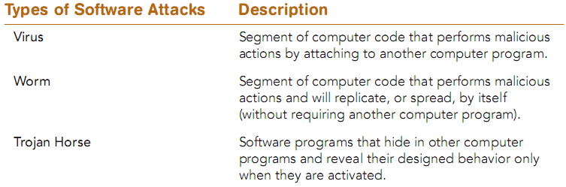
Software Attacks

Slide 17
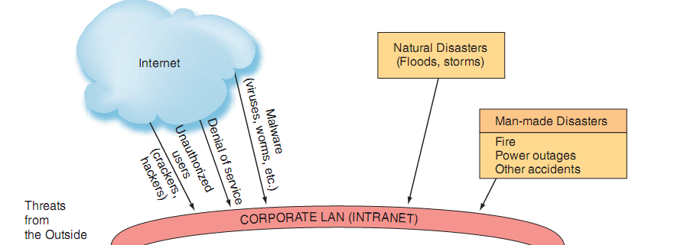
Security threats from the outside

Slide 18
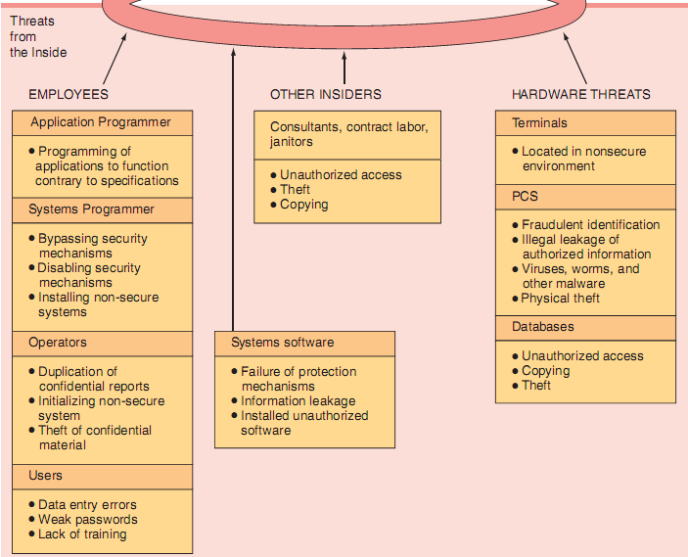
Security threats
from the inside

Slide 19
Protecting Information Resources
A risk is the probability that a threat will impact an information resource.
The goal of risk management is to identify, control, and minimize the impact of threat.
Risk management involves three processes:
risk analysis
risk mitigation
controls evaluation

Slide 20
Risk analysis
Process by which an organization assesses the value of each asset being protected, estimates the probability that each asset will be compromised, and compares the probable costs of the asset’s being compromised with the costs of protecting that asset.
Organizations perform risk analysis to ensure that their information systems’ security programs are cost effective.
The risk analysis process prioritizes the assets to be protected based on each asset’s value, its probability of being compromised, and the estimated cost of its protection.
The organization then considers how to mitigate the risk.

Slide 21
Risk mitigation
The organization takes concrete actions against risks.
Risk mitigation has two function:
implementing controls to prevent identiﬁed threats from occurring
developing a means of recovery should the threat become a reality.

Slide 22
Risk mitigation strategies
Risk acceptance: Accept the potential risk, continue operating with no controls, and absorb any damages that occur.
Risk limitation: Limit the risk by implementing controls that minimize the impact of the threat.
Risk transference: Transfer the risk by using other means to compensate for the loss, such as by purchasing insurance.

Slide 23
The Difficulties in Protecting Information Resources
Hundreds of potential threats exist.
Computing resources may be situated in many locations.
Many individuals control information assets.
Computer networks can be located outside the organization and are difﬁcult to protect.
Rapid technological changes make some controls obsolete as soon as they are installed.

Slide 24
The Difficulties in Protecting Information Resources
Many computer crimes are undetected for a long period of time, so it is difﬁcult to learn from experience.
People tend to violate security procedures because the procedures are inconvenient.
The cost of preventing hazards can be very high. Therefore, most organizations simply cannot afford to protect against all possible hazards

Slide 25
Controls evaluation
The organization identiﬁes security deﬁciencies and calculates the costs of implementing adequate control measures.
If the costs of implementing a control are greater than the value of the asset being protected, then control is not cost effective.

Slide 26
Controls
Defense mechanisms, also called countermeasures, employed by organizations to protect their information assets.
Security controls are designed to protect all of the components of an information system, including data, software, hardware, and networks.
The categories of controls are
physical,
access,
communications,
application controls

Slide 27
physical controls
Controls that restrict unauthorized individuals from gaining access to a company’s computer facilities.
walls, doors, fencing, gates, locks, badges, guards, and alarm systems
pressure sensors, temperature sensors, and motion detectors.

Slide 28
access controls
Controls that restrict unauthorized individuals from using information resources and are concerned with user identiﬁcation
These controls involve two major functions:
Authentication : determines the identity of the person requiring access
Authorization : determines which actions, rights, or privileges the person has, based on veriﬁed identity.

Slide 29
Methods to identify authorized personnel
Something the User Is > biometric
Something the User Has
Something the User Does
Something the User Knows.

Slide 30
Passwords
They should be difﬁcult to guess.
They should be longer rather than shorter.
They should have uppercase letters, lowercase letters, numbers, and special characters.
They should not be a recognizable word.
They should not be the name of anything or anyone familiar, such as family names or names of pets.
They should not be a recognizable string of numbers, such as a Social Security number or birthday

Slide 31
communications controls
Controls that deal with the movement of data across networks
Firewalls : a system that prevents a speciﬁc type of information from moving between untrusted networks.
Anti-malware systems : antivirus software, are software packages that attempt to identify and eliminate viruses.

Slide 32
application controls
Controls that protect speciﬁc applications
Three major categories of these controls are:
Input control : programmed routines that are performed to edit input data for errors before they are processed.
Processing control : match employee time cards with a master payroll ﬁle and report missing or duplicate time cards
output controls

